Slide 1
901: Part 2

Slide 2

Dimitris Papailiopoulos
Advances and Challenges in Distributed Machine Learning

Slide 3
Mostly Challenges

Slide 4
Overview
Multicore vs. Distributed
Algorithm of choice: minibatch SGD
Open challenges with Performance Gains/Analysis
Convergence/Generalization/Speedup/Delays?
Straggler Nodes and How to Deal with them.

Slide 5
Stochastic Gradient Descent
SGD can take 10+ days on large data sets
[DawnBench, 2017]
Goal:
Speed up Machine Learning
Different names and flavors
ML / Optimization / Statistics / EE
Perceptron
Incremental Gradient
Back Propagation (NNs)
Oja’s iteration (PCA)
LMS Filter
…
Has been around for a while, for good reasons:
Robust to noise
Simple to implement
Near-optimal learning performance *
Small computational foot-print
Goal: Minimize losses
loss for data point i
SGD: An Über-algorithm

Slide 6
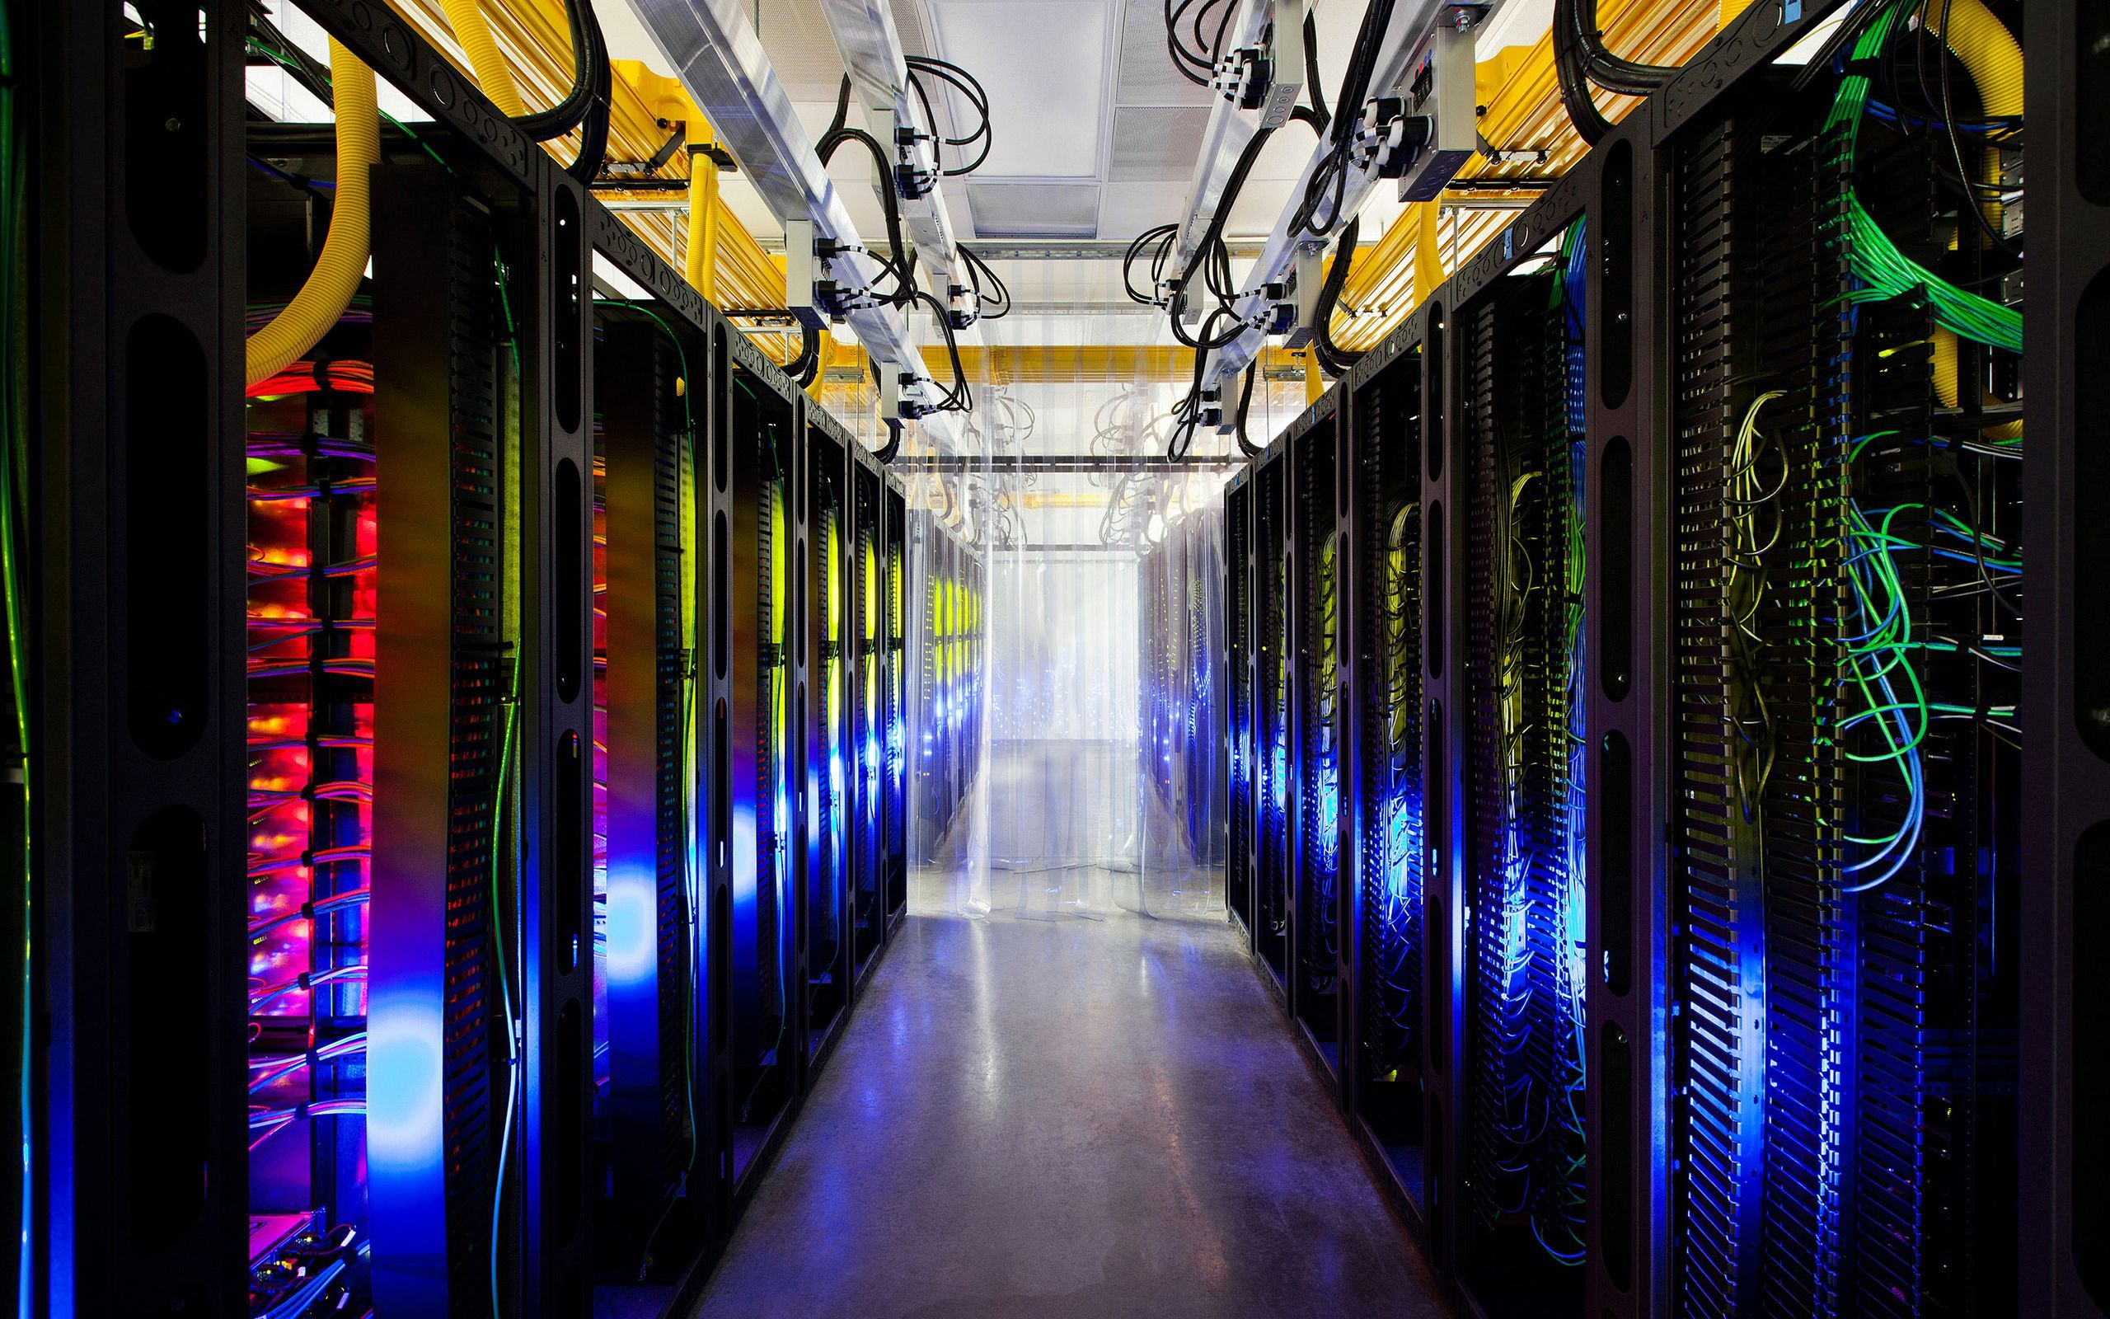
Idea:
Train at scale

Slide 7
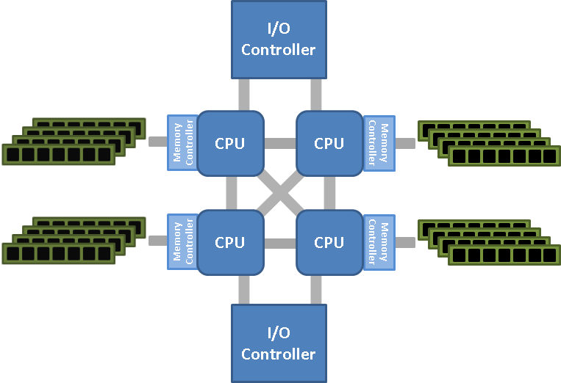
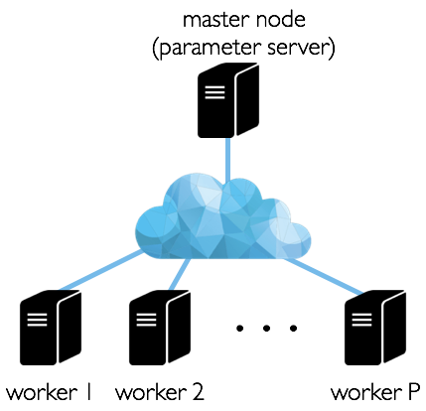
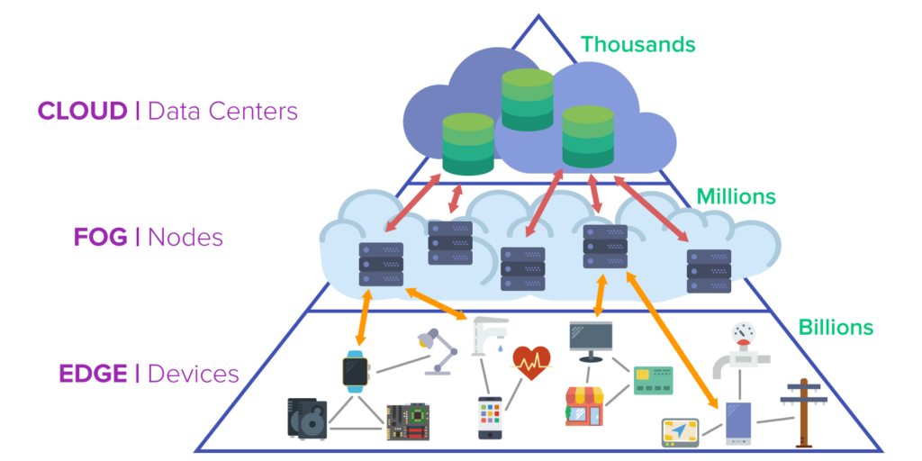
Platforms
Parallel
Single machine, multicore
Multi-socket NUMA
Distributed

Slide 8
Parallel vs. Distributed
Parallel (CPU)
Single machine, many cores (usually up to100s)
Shared memory (all cores have access to RAM)
Comm. to RAM is cheap
Distributed
Many machines (usually up to1000s) connected via network
Shared-nothing architecture (each node has its own resources)
Communication costs non-negligible
Scaling up vs. Scaling out

Slide 9
Scaling up vs. out
What we’d ideally like
Cores
RAM
Comm. Cost
Cost to build
Feasible solutions:
Scaling up:
Getting the largest machine possible, with maxed out RAM
Scaling out:
Getting a bunch of machines, and linking them together

Slide 10
Scaling up vs. out
Scaling up
Pros:
RAM comm. cheap (no network)
Less impl. overheads
Less power/smaller footprint
Cons:
100s cores/machine = expensive
Smaller fault tolerance
Limited upgradability
Scaling out
Pros:
Much cheaper (especially on Ec2)
Can replace faulty parts
Better fault tolerance (if it matters)
Cons:
Network bound
Major implementation overheads
Large power footprint

Slide 11
Choosing your Hardware

Slide 12



Price Comparisons for 128 Cores
Single machine multi-core (CPU)
For 4 Tesla V100 GPU work station:
Alternative Choice: Rent instances
more than $60,000

Slide 13
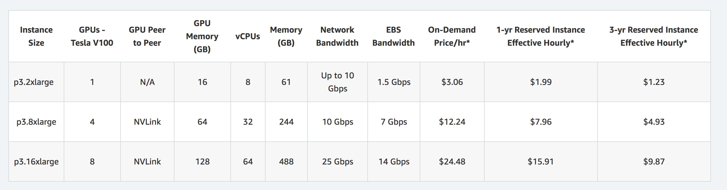
EC2 Price for Scaling-up to 128 cores
Alternative Choice: Rent Instances
Price for 4 GPUs: $8/hr 10 days nonstop/month, for a year ~ $23,000

Slide 14
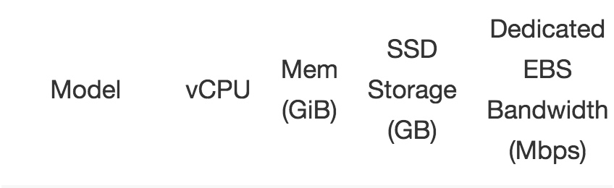
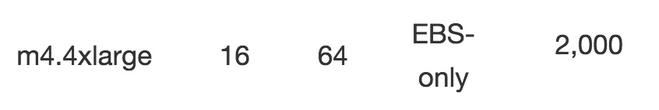
EC2 Price for Scaling-out to 128 cores
Say we want 128 cores, but are OK with not single machine
Price: $8x 0.11/hr 1-year nonstop experiments ~ $7,500
Note! Network BW can be 100x slower than single machine Bus BW

Slide 15
Let’s Think about Running Stuff

Slide 16
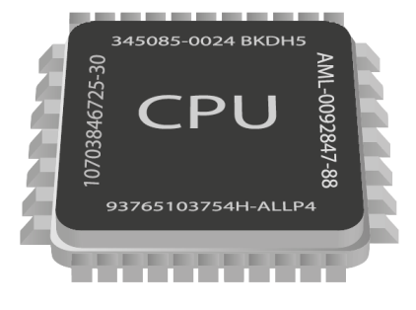









Distribute the effort!
Theory
Many models weaker than one
Delays and Slow Nodes
Communication Costs
Barriers to entry / High Cost
Implementation Overhead
Nontrivial choice of ML-framework
Several issues
Practice

Slide 17
Choosing an Algorithm

Slide 18
The Master-worker Setting

Slide 19
Algorithm of choice: minibatch SGD

Slide 20
Algorithm of choice: minibatch SGD
Stores the model
Gradient Computations

Slide 21
Algorithm of choice: minibatch SGD

Slide 22
Algorithm of choice: minibatch SGD

Slide 23
Algorithm of choice: minibatch SGD

Slide 24
Algorithm of choice: minibatch SGD

Slide 25
Algorithm of choice: minibatch SGD
Repeat distributed iterations until
we are happy with the model

Slide 26
Evaluating the performance of Distributed ML

Slide 27
Many Questions….
How fast does minibatch-SGD converge?
How can we measure speedups?
Comm. is expensive, how often do we average?
How do we choose the right model?
What happens with delayed nodes?
Does fault tolerance matter?

Slide 28
Convergence?
How does minibatch SGD compare against serial SGD?

Slide 29
Convergence?
How does minibatch SGD compare against serial SGD?
Main questions:
Convergence after T gradient computations
Answer is Complicated: Depends on Problem
Generally if batch B_0 > B(data, loss)
Minibatch SGD offers no speedup.

Slide 30
Generalization?
Do models trained with minibatch SGD generalize

Slide 31
Generalization?
Do models trained with minibatch SGD generalize
Main questions:
Generalization after T gradient computations
Answer its Complicated: Depends on Problem
Generally if batch B_0 > B(data, loss)
Minibatch SGD offers worse generalization

Slide 32
How to chose the right model
Some models are better than others,
even from a systems perspective

Slide 33
How to chose the right model
Some models are better than others,
even from a systems perspective

Slide 34
How to chose the right model
Some models are better than others,
even from a systems perspective
Does it fit in a single machine?
Is model architecture amenable
to low communication?
Some models easier to partition
Can we increase sparsity (less comm)
without losing with accuracy?

Slide 35
How to chose the right model
Some models are better than others,
even from a systems perspective

Slide 36
Parallelism Gains?

Slide 37
Parallelism Gains?
Weak Scaling
Strong Scaling

Slide 38
Parallelism Gains?
Let’s see
https://talwalkarlab.github.io/paleo/

Slide 39
Parallelism Gains?
Weak Scaling: Easy

Slide 40
Parallelism Gains?
Weak Scaling: Easy
Strong Scaling: Nontrivial, and not there yet
Major Open Problem!!!

Slide 41
As if the Design landscape was not complicated enough…
How can we mitigate Delays and Straggler Nodes?

Slide 42
Large-scale Distributed Machine Learning Systems
Storage
Communication
Computation
1
Δ
1
Δ
Distributed Data Storage
Δ
2
Δ
2
Aggregator
Data
Δ
Network
Δ
Δ
Δ
n
Δ
n
Δ
Q: Can we use “fault tolerance” solutions
to robustify distributed ML speedups?
Notes:
Large-scale computing systems have 3 main layers: Storage layer, Communication Layer, and Computation Layer. Data is read from the storage layer, and transmitted through the network towards the computing nodes. The new results of computation are then stored again to complete the loop. each of these steps incurs some delay and uncertainty. Can codes robustify algorithms against this system noise?

Slide 43
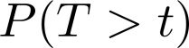
Straggler (i.e., slow) Nodes
f=f₁+f₂+f₃
Measured on Amazon AWS
f₁
f₂
f₃
t: latency (second)
f₁
Can we “robustify” distributed algorithms
against stragglers?
f₂
f₃

Slide 44

“Uncoded” Distributed Matrix Multiplication
We want to multiply A and X
Distributed setup: 3 workers, 1 master
Bulk Synchronous (Spark/MR/etc)
A₁X
M
A₂X
A₁
A₃X
A
A₂
W₁
W₂
W₃
A₃
A₁
X
A₂
X
A₃
X

Slide 45
MDS-coded Matrix Multiplication
A’₁X
M
A₁
A’₁
A’₂X
A
A₂
A
W₁
W₂
W₃
A’₂
A₃
A’₁
X
A’₂
X
_{(A’1+A’2)}
X
+

Slide 46

MDS-coded Matrix Multiplication
M
A₁X
A₁
A₂X
AX
A₃X
A
A₂
W₁
W₂
W₃
A₃
A₁
X
A₂
X
A₃
X
W₁
W₂
W₃

Slide 47

MDS-coded Matrix Multiplication
M
A₁X
M
A₁X
A₁
A₂X
AX
A₁
AX
A₃X
A₂X
A
A₂
A
W₁
W₂
W₃
A₂
W₁
W₂
W₃
A₃
A₁
X
A₂
X
A₃
X
A₁
X
A₂
X
A₁+A₂
X
W₁
W₁
W₂
W₂
W₃
W₃
Gain:
time(uncoded) = slowest node
time(MDS coded) = 2nd slowest node

Slide 48
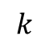
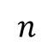
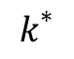
Coded Computation for Linear Operations
Assumptions:
Linearity
Compute time model = constant + exponential RV (shifted exp.)
Compute times are i.i.d.
Theorem:
E[T]
uncoded
replication
coded
1
k = all nodes - parity nodes

Slide 49
Experimental Results w/ 24 EC2 instances
E[T]
(ms)
500
4-rep
400
3-rep
uncoded (1-rep)
300
2-rep
> 30% speed up
(24,23)
(24,22)
(24,20)
k
200
6 8 10 12 14 16 18 20 22 24

Slide 50
Open problems
Coded computation with low decoding complexity
Nonlinear / nonconvex functions
Low-density generator matrix (LDGM) codes
Locally Repairable Codes
Sparsity/Graph Structure?
Most times “lossy” learning is fine, maybe “terminate” slow nodes?
f=f₁+f₂+f₃+f₄
f₁
f₂
f₃
f₄
f₁+f₂+f₃+f₄
`

Slide 52
Large-scale Distributed Machine Learning Systems
Storage
Communication
Computation
1
Δ
1
Δ
Distributed Data Storage
Δ
2
Δ
2
Aggregator
Data
Δ
Network
Δ
Δ
Δ
n
Δ
n
Δ
Notes:
Large-scale computing systems have 3 main layers: Storage layer, Communication Layer, and Computation Layer. Data is read from the storage layer, and transmitted through the network towards the computing nodes. The new results of computation are then stored again to complete the loop. each of these steps incurs some delay and uncertainty. Can codes robustify algorithms against this system noise?

Slide 53
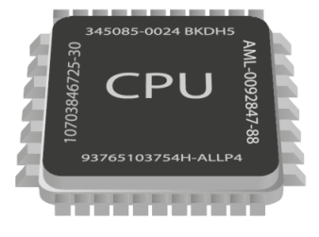
Parallel Stochastic Gradient Descent (PSGD)
Data
Model
Random
SGD
SGD
SGD
Merge models

Slide 54
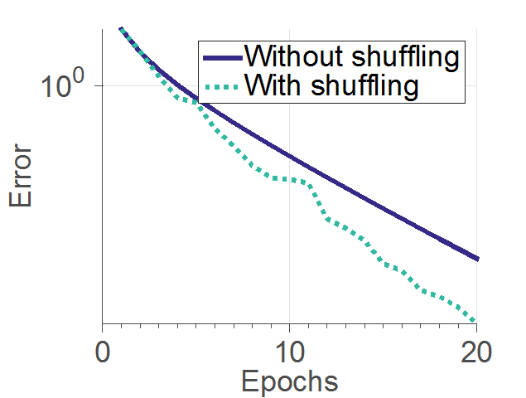
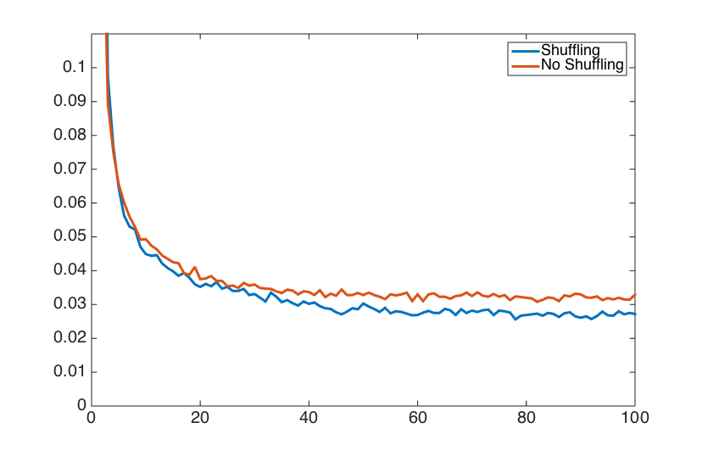
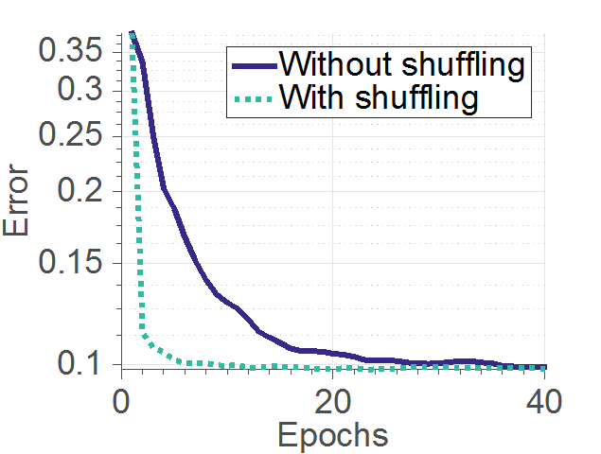
Parallel Stochastic Gradient Descent (PSGD)
Data shuffling
Data
Model
Random
SGD
SGD
SGD
PSGD with shuffling converges faster
Merge models
* [Recht and Re, 2013], [Bottou, 2012], [Zhang and Re, 2014], [Gurbuzbalaban et al., 2015], [Ioffe and Szegedy, 2015], [Zhang et al. 2015]

Slide 55
Data Shuffling
1
2
2
3
3
A
2
3
4
Comm @ round 2
= 2 blocks
M
W₁
W₂
1
2
3
4
 | Blocks 1, 2 | Blocks 3, 4
 | Blocks 1, 3 | Blocks 2, 4
Pass 1
Pass 2

Slide 56
Data Shuffling
1
2
2
3
3
A
2
3
4
Comm @ round 2
= 2 blocks
M
W₁
W₂
1
2
3
4
 | Blocks 1, 2 | Blocks 3, 4
 | Blocks 1, 3 | Blocks 2, 4
Pass 1
Pass 2

Slide 57
Coded Shuffling
1
2
2
3
A
3
4
1
2
2
3
A
3
4
Comm @ round 2
= 2 blocks
M
M
W₁
W₂
W₁
W₂
1
3
2
4
1
2
2
3
3
4
 | Blocks 1, 2 | Blocks 3, 4
 | Blocks 1, 3 | Blocks 2, 4
Pass 1
Pass 2

Slide 58
Coded Shuffling
1
2
2
3
A
3
4
1
2
2
3
A
3
4
2+3
2+3
Comm @ round 2
= 2 blocks
M
Comm @ round 2
= 1 blocks
M
W₁
W₂
W₁
W₂
1
3
2
4
1
3
2
2
3
4
 | Blocks 1, 2 | Blocks 3, 4
 | Blocks 1, 3 | Blocks 2, 4
Pass 1
Pass 2

Slide 59
Coded Shuffling
Theorem:
n = # data points
P = # workers
β = excess memory per worker ( = how much a worker can store / (n/P) )
Learning setup: each pass, the master randomly permutes data
Then, communication costs (in expectation):

Slide 60
Experiments
10
9
Uncoded
n = 10^7
p = 20
8
7
6
# of transmissions / 10^6
5
Simulation
4
3
Theory
2
1
2
4
6
8
10
12
14
16
18
20
Memory overhead

Slide 61
Regression on amazon EC2, 20 workers
35% speed up

Slide 62
Coded Shuffling Conclusions
Shuffling data improves PSGD convergence performance
Q: How much?
Coded shuffling algorithm / system design
Future directions
Integration w/ existing ML frameworks (e.g. TensorFlow)
Coded PSGD + Coded Shuffling?

Slide 63
Let’s wrap this up

Slide 64

You want to be here!

